Slide 1
Time Spent on Mathematics vs Programming
DATA 211 Course Project
Natnael Berhanu
December 12, 2024

Slide 2
Objective
Objective: Analyze daily study time for Mathematics and Programming classes.
Key Question: Is the average time spent studying Mathematics greater than Programming?

Slide 3
Hypothesis Testing
Claim: The mean time spent on Mathematics is greater than the mean time spent on Programming.
Variables:
Dependent: Time spent studying (in minutes)
Independent: Subject type (Programming or Mathematics)

Slide 4
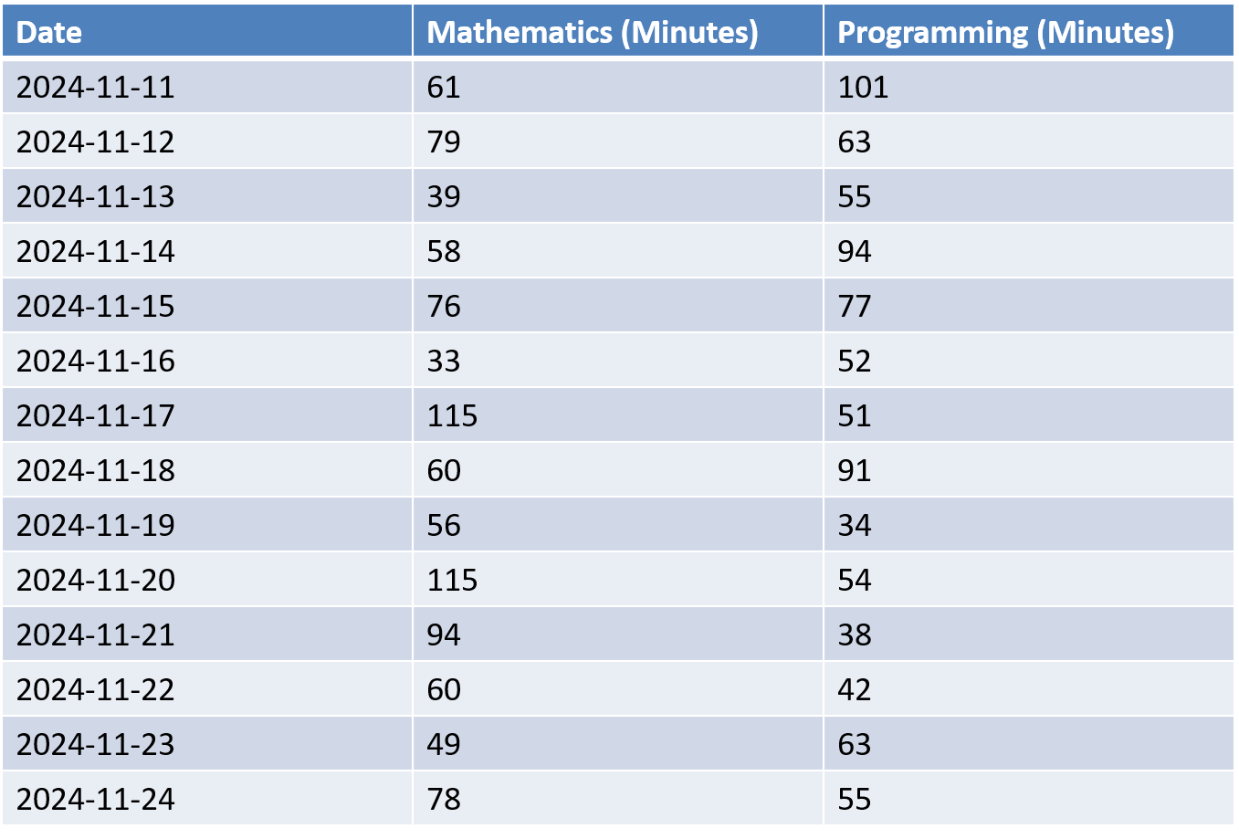
Data Collection
Period Analyzed: Two weeks (Nov 10, 2024 – Nov 24, 2024) Subjects:
Mathematics: Topics include Statistics and Discrete Mathematics.
Programming: Topics include Computational Thinking With Programming and Data Visualization.

Slide 5
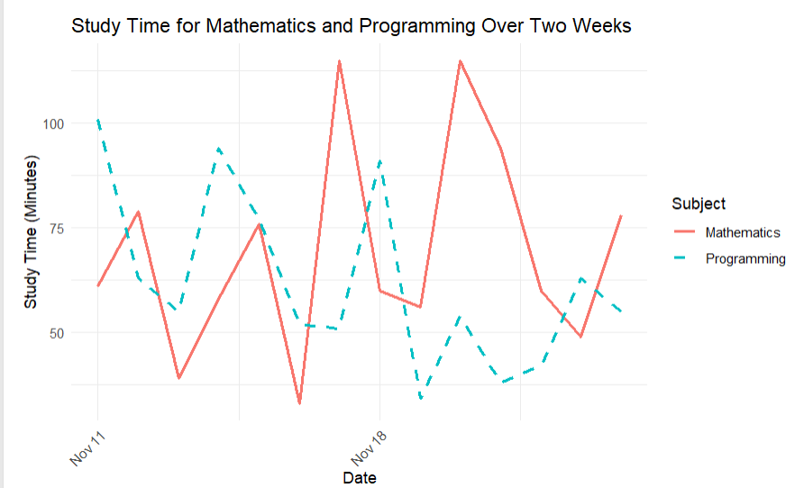
Study Time for Mathematics and Programming
The graph shows daily study times for Mathematics and Programming over two weeks.
Mathematics shows higher peaks, while Programming is more consistent.

Slide 6
Hypothesis Testing
Null Hypothesis (H₀): The average time spent Mathematics is less than or equal to the average time spent on Programming. H0​: μMathematics ​≤ μProgramming​
Alternative Hypothesis (Hₐ): The average time spent on Mathematics is greater than the average time spent on Programming. Ha: μMathematics > μProgramming

Slide 7
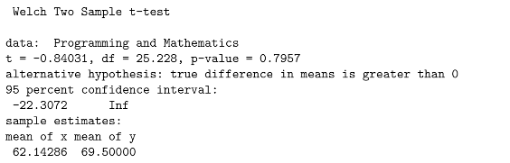
Hypothesis Testing
t-statistic: -0.84031
Degrees of Freedom (df): 25.228
p-value: 0.7957
95% Confidence Interval: [-22.3072, Inf]
Sample Means:
mean of x (Programming): 62.14 minutes
mean of y (Mathematics): 69.50 minutes

Slide 8
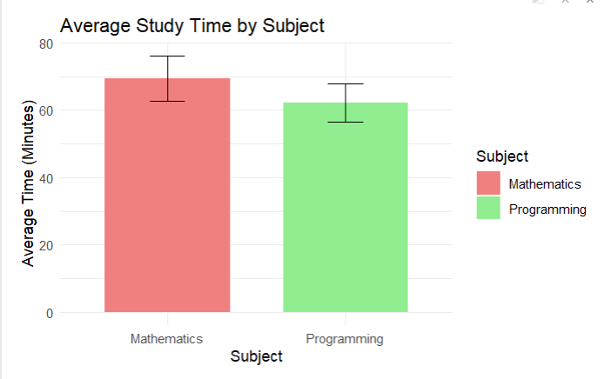
Visualization 1: Average Study Time by Subject
The bar chart compares average study times for Mathematics and Programming.
Mathematics has a slightly higher average, but the difference is not statistically significant.
Error bars represent standard errors

Slide 9
CONCLUSION
Since the p-value (0.7957) is greater than 0.05, we fail to reject the null hypothesis.
Although the data shows that I spent, on average, more time studying Mathematics (69.50 minutes) compared to Programming (62.14 minutes), this difference is not statistically significant.
This means the observed variation in study times is likely due to random chance rather than a meaningful difference in study habits.

Slide 10
GitHub link
Natnael010/Data-211-01

